Slide 1
大学英语 Lesson 7 动词
主讲人：周丽莉

Slide 2
1
动词的种类
CONTENTS
2
动词的用法

Slide 3
定
义
表示动作或状态的词叫做动词。
e.g.The boy runs fast.
The boy is a student .

Slide 4
下面哪些词不是动词？
raise they write the be become remains shall myself will done can must burning second wonderful care for nothing until dreamed

Slide 5
动词的种类
01

Slide 6

一、动词的种类
谓语动词
按作用功能分
不定式
非谓语动词
动名词
分词（现在&过去）
规则变化动词
动词分类
按词尾构成分
不规则变化动词
行为动词
连系动词
按意义分
情态动词
助动词

Slide 7
动词的用法
02

Slide 8

01
动词的基本形式
02
行为动词
03
系动词
动词的用法
04
助动词
05
情态动词
06
重点动词及词组

Slide 9
02.动词的用法
2.1 动词的基本形式

Slide 10
（一）主语为第三人称单数的动词变化规则
一般情况 | 直接在动词词尾+s | get→gets; take→takes
以sh, ch, o, s, x结尾的动词 | 在词尾+es | teach→teaches; fix→fixes; go→goes
以辅音字母+y结尾的动词 （a,e,i,o,u是元音字母，其他的21个都是辅音字母） | 变y为i,再+es | study→ studies; try→tries
特殊变化 | 不规则 | have---has; be---is; do---does
什么是第三人称单数？
首先要搞清楚第一、第二、第三人称各是什么。第一人称就是"我"和"我们"。第二人称是"你"和"你们"。第三人称单数是"他"、"她"和"它"，复数"他们"、"她们"和"它们"，以及其他表事物及称呼的名称。
第三人称单数做主语，则是第三人称单数是"他"、"她"和"它"，以及其他单数事物及称呼名词作主语的情况。这样的情况，在一般现在时时，句子中的谓语动词用第三人称单数的动词变化规则。
如：He is a boy.
Lily reads a book.
Six is a lucky number.
An apple comes from one of my friends.

Slide 11


Exercise
1.写出下列动词的第三人称单数形式
s
pass
sit
look
es
s
swim
s
read
s
/carries
s
es
plant
carry
come
watch
s
fly
/flies
study
/studies
brush
es
teach
es
play
wash
s
say
es
s
finish
es
s
drink
es
snow
guess
s
take
s

Slide 12
Exercise
1.He _____ teeth every morning.
A. brush B. brushes C. brushing
2._____ he swim every afternoon?
A. Do B. Does C. Doing
3.My father ______a new bike.
A. have B. has C. having
4. John ________ like his father.
A. look B. looks C.lookes

Slide 13
（二）动词的现在分词变化规则
一般情况 | 直接在动词词尾+ing | work --- working sleep ---sleeping study ---- studying
动词以不发音的e结尾 | 要去e加ing | take ----- taking make ----- making dance ----- dancing
以辅元辅结尾的 | 要双写末尾字母，再加ing | cut --cutting put ---putting begin --beginning stop---stopping swim---swimming get---getting shop---shopping sit--sitting
以-ie结尾的动词 | 变ie为y再加ing | lie ---lying tie ----- tying die---dying
特殊 | 不规则(动词变化不规则表中逐个记忆) | control----controlling travel----travel(l)ing picnic----picnicking

Slide 14

Exercise
1.The boy ____________ ( draw) a picture now.
2. Listen .Some girls ___________ ( sing) in the
classroom .
3. My mother _____________ ( cook ) some nice
food now.
4. What _____ you ______ ( do ) now?
5. Look . They __________( have) an English lesson .
is drawing
are singing
is cooking
are
doing
are having

Slide 15
（三）动词的过去式和过去分词的构成方法
一般情况 | 在动词原形后加-ed （注意：-ed在清辅音音素后发音为[t]；在浊辅音后发音为[d]，在元音后发音也为[d] ；-ed在[t]、[d]后发音为[id]，如needed[ni:did]） | work --- worked---worked ask---asked---asked call---called---called
动词以e结尾 | 直接+d | like --- liked---liked
以辅元辅结尾的 | 要双写末尾字母，再加ed | stop---stopped---stopped prefer---preferred---preferred
以辅音字母+ y 结尾的动词 | 变y为i，再+ ed | carry---carried---carried
特殊 | 不规则(动词变化不规则表中逐个记忆) | control---controlled---controlled travel---travel(l)ed---travel(l)ed picnic---picnicked---picnicked do---did---done have---had---had

Slide 16
Exercise
1. Lee ________ his mobile phone at home.
A. leave B. leaves C. leaved D. left
2. _____ he ________ a good rest? No, he didn’t.
A. Do, had B. Did, have C. Did, had D. Was, had
3. As soon as he ________, he ______ to his family.
A. arrived, writes B. arrived, written
C. arrived, wrote D. arriveds, write

Slide 17
动词的五种形式
小结：
原形 | 第三人称单数 | 过去式 | 过去分词 | 现在分词
work
write
have
do
works
worked
worked
working
writes
wrote
written
writing
has
had
had
having
does
did
done
doing

Slide 18
02.动词的用法
2.2 行为动词（实义动词）

Slide 19
概念：
行为动词也叫实义动词，是表示行为、动作或状态的词。
它的词义完整，可以单独作谓语。
英语中按动词后可否直接跟宾语，可把实义动词分成及
物动词和不及物动词。
1.不及物动词(intransitive verb)——
本身意义完整后面不需跟宾语的实义动词，用vi表示。
如：My watch stopped.
2. 及物动词 (transitive verb)——
后面必须跟宾语意义才完整的实义动词，用vt表示。
如：We planted many trees around our school.

Slide 20
注意
及物动词后面必须跟宾语，可以用于被动语态；
常见的及物动词如：tell，make, take, hand，buy, like, raise, seat,say,find, have， show, see, give,ask，offer,prevent, regard,teach，promise, forget, receive, catch, dress, found, invent, marry, observe, supply, select, suppose,serve,....
A girl opened the door.（必须跟宾语）
The door was opened by a girl. (被动语态)

Slide 21
注意
不及物动词后面不能跟宾语，不能用于被动语态, 可以加任意状语；
常见的不及物动词如：
go, give，fail，happen , lie, rise, agree,look, succeed,die,rain, come, occur, sit, walk, run, sleep, listen, remain , belong, fall, exist, arrive, sail, hurry....
The sun rises.
It happened in June, 1932.
但是不及物动词后面如果需要宾语时，必须加上相应的介词，如to, of , at，on, for 等。
The foreigners arrived （at our school this morning）

Slide 22
注意
有些动词既可以是及物动词也可以是不及物动词
Shall I begin at once?
She began working as a librarian after she left school.
When did they leave Beijing?
They left last week.
She’s studying medicine.
She studies hard.
She’s typing a letter.
She’s typing.
Don’t move my things.
The train is moving now.
vi.
vt.
vt.
vi.
vt.
vi.
vt.
vi.
vt.
vi.

Slide 23
注意
延续性动词v.s.非延续性动词（P120顶部）
非延续性动词——表示短暂性动作，即“一发生就结束了”。
这类动词一般不能与表示一段时间的状语连用。
常见的有：go, come, leave, arrive, lose, land, catch, join, kill, find, occur, happen, die.....
✘
He has joined the organizetion for a long time.
He has been a member of the organization for a long time.
✔

Slide 24
拓展：
有些动词可以接动词不定式(to do---)作宾语
记忆口诀：
决心学会想希望，
拒绝设法愿假装，
主动应答选计划，
同意请求帮一帮。
decide , learn, want, hope /expect / wish,
refuse, manage, care, pretend,
offer, promise, choose, plan,
agree, ask , help

Slide 25
拓展：
有些动词可接动名词(v-ing)做宾语
记忆口诀：
考虑建议盼原谅，承认推迟没得想，
避免错过继续练，否认完成就欣赏，
禁止想象才冒险，不禁介意准逃亡。
consider, suggest/advise, look forward to, excuse
admit, delay/put off,
avoid, miss /keep, practise
deny, finish, enjoy,
forbid, imagine, risk,
can’t help, mind, allow/permit, escape

Slide 26
Exercise
1. Lily finished ______ the book yesterday.
A. read B. reading C. to read D. reads
2. —What are you busy ______ these days?—Nothing much.
A. do B. doing C. to do D. done
3. —Do you want to eat something?
—____, thanks. I am feeling sick now. I don’t feel like ____.
A. Yes; eating something B. No; to eat anything
C. Yes; to eat anything D. No; eating anything
4. No matter how hard it is, we’ll keep ______ until we make it.
A. failed B. failing C. tried D. trying

Slide 27
后面既能接动名词，又可接动词不定式的动词有：
1.begin,start(开始)，like, love,perfer(喜爱), hate(憎恨)，continue(继续)可以接动词不定式或-ing形式作宾语。
+to do
+doing
表示具体的动作
表示习惯行为
I like swimming.
我喜欢游泳。
I like to go swimming.
我现在想去游泳。

Slide 28
2. stop(停止)，forget(忘记)，remember(记得)，try(试)，go on(继续)等动词接不定式和-ing形式意义有区别。试比较：
stop to do sth.停下来去做另一件事
stop doing sth.停止(正在)做某事
go on to do sth.接着做另一件事(已做完一件)
go on doing sth.继续做(原来未做完的)某件事）
forget to do sth.忘记去做某事(还未做)
forget doing sth.忘记做过某事(已经做)
remember to do sth.记住去做某事(还未做)
remember doing sth.记住曾做过某事

Slide 29
其他：
try to do sth. 尽力做某事
try doing sth.试着做某事
mean to do sth. 打算做某事
mean doing sth.意味着某事
can’t help to do sth 不能帮忙做某事
can’t help doing 忍不住做某事
If you don’t feel well, you may just ______
A. stopped reading B. stop reading
C. stopped to read D. stop to read

Slide 30
Exercise
1. My mother often asks me ___early.
A.get up B. got up C. getting up D. to get up
2.Yesterday afternoon Mrs Green told the boys _____
football in the classroom.
A. didn’t play B. to not play C. not play D. not to play
3.I hear someone ____ at the door.
Please go and see who _____is.
A.knock; it B. knocking; it
C. knocking; he D. knock; he

Slide 31
02.动词的用法
2.3 系动词

Slide 32
系动词 Link Verb
系动词，它本身有词义，但不能单独用作谓语，后边必须跟表语（通常为名词或形容词），构成系表结构说明主语的状况、性质、特征等情况。
e.g. He likes his father.
I am interested in music.

Slide 33
be 动词 | 表状态，表示“是”：am, is, are, was, were | I am a teacher.
感官动词 | look, smell, taste, sound, feel | The flower smells good.
“主观判断”类 | seem(似乎是)，appear(似乎、显得)，prove(证明是),turn out (结果是, 证明是) | You seem happy.
“状态变化”类 | 表示主语从一种状态变化成另一种状态become, turn, grow, go, come, fall, get | Her face turns red.
“状态持续”类 | 表示主语持续某种状态 remain(依然)，keep(保持)，stay(保持)，lie (呈…状态,置于), continue(继续、仍旧)等 | You should keep warm.

Slide 34


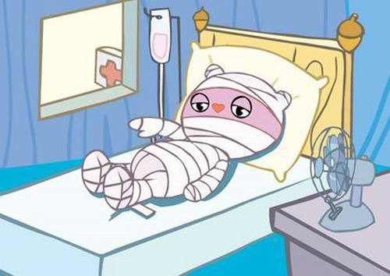
1）状态类系动词(以be动词为代表)
用来表示主语的性质或状态。意思“是”
e.g.
He is a teacher.
He is ill.

Slide 35
be动词
口诀：
我用 am，你用are
is连着他她它
单数不可数记得用 is,
复数后面are, are, are。

Slide 36
is
他是一个男生。
He is a boy.
她是一个女生。
She is a girl.
The pencil is long.
这只笔是长的。（某物）
Kitty is thin.
Kitty是痩的。（某人）
The milk is white.
牛奶是白色的。(不可数）
它是一只小狗。
It is a dog.

Slide 37
You are a boy.
You are friends.
are
We are friends.
They are monkeys.
My eyes are big.

Slide 38
Exercise
用动词am, is, are填空(请注意大小写)
1. Where ______ Ann? She ______ here.
2. How old ______ you? I ______ thirteen.
3. ______ you Mr Read? Yes, I ______.
4. What ______ your name?My name ____ Fang Fang.
5. What grade ______ you in? I ______ in Grade Two.
is
is
are
am
Are
am
is
is
are
am

Slide 39
1. They late.
A. am B. is C. are
2. You a student.
A. am B. is C. are
3. The cloud white.
A. am B. is C. are
4. I a student. You a teacher.
A . am is B. am are C. is are
5. We friends.
A. am B. is C. are
6. He my father.
She my mother . They both doctors .
A. is is are B. am is are C. is is am

Slide 40
be动词的否定句
be动词后加not
1.He is a teacher.
He is not a teacher.
2.They are twins.
They are not twins.

Slide 41
be动词的缩写
I’m
You’re
I am= You are=
He is= She is=
We are= It is=
They are=
He’s
She’s
We’re
It’s
They’re
否定形式的缩写：
is not= isn’t are not= aren’t
am not没有缩写形式！

Slide 42
有Be动词的陈述句改为一般疑问句的 基本步骤(1)
He is Jack.
Is he Jack?
找出be动词
将be动词放到最前面
首字母大写,原来的首字母改掉,其他照抄
句号改成问号
She is Mary.
is She Mary.
Is she Mary.
Is she Mary?

Slide 43
有Be动词的陈述句改为一般疑问句的 基本步骤(2)
I am Lucy.
Are you Lucy?
找出be动词
将be动词放到最前面
主语是第一人称I改为第二人称you,对应am改成are(my改成your)
句号改成问号
I am Mary.
Am I Mary.
Are you Mary.
Are you Mary?

Slide 44
一般疑问句（Simple Quesiton）
陈述句
一般疑问句
It is a fish.
They are fish.
This is your book.
I am a student.
My son is a teacher.
This is a car.
Is it a fish?
Are they fish?
Is this your book?
Are you a sthdent?
Is your son a teacher?
Is this a car?

Slide 45
is
Is she from Canada?
Yes, she is.
She ____ from Canada. 一般疑问句：_________________ 肯定回答：___________________ 否定回答：__________________
No, she is not.
缩写形式：
No, she isn’t.

Slide 46


2）感官系动词
用来表示人体感官功能的动词，look，feel，sound，taste，smell，这类动词加上形容词，表示人或事物的特征、性质或状态。sweat
e.g.She looks beautiful. This flower smells sweet.

Slide 47
3）主观判断类
seem(似乎是)，appear(似乎、显得)，prove(证明是),turn out (结果是, 证明是)
e.g.The weather turned out to be fine.

Slide 48
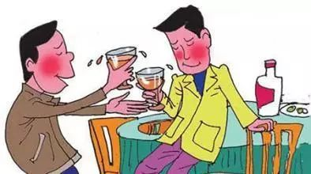
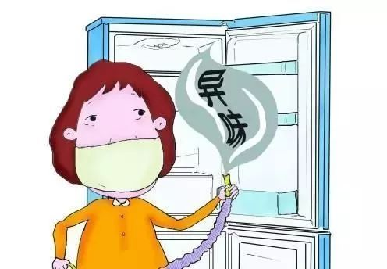
4）变化类系动词
grow, get, fall, go, become, turn
e.g.His face turned red. The meat goes bad.

Slide 49
become | 表示“变成”，比较正式，通常表示“变”这个动作已经完成 | He had a long walk and became tired. 他走了很远的路，累了。
get | 通常表示温度、时间、岁数等变化，动作也已完成,和 become 相比更加口语化 | He did business and got rich. 他做生意发了。
go | 表示“变得（糟糕、由好变坏、由强变弱）”,常见于“负能量的”形容词，如 bad、angry、blind、hungry 等 。 | She went blind when she was old. 她老年的时候，双目失明。
grow | 表示“逐渐变得”，常需要经历一个过程，慢慢地变化，所以常用来表示身高、岁数、经验等的改变 | She has grown much taller. 她长高了很多。
turn | 表示“变得”，通常强调与原来的属性不同了，常常表示颜色、性质、状态等发生的“显而易见的变化” | Leaves turn yellow in fall. 树叶在秋天会变黄。
fall | 表示“进入（某种状态），开始变成（某事物）” | He falls in love with this country. 他爱上了这个国家。

Slide 50
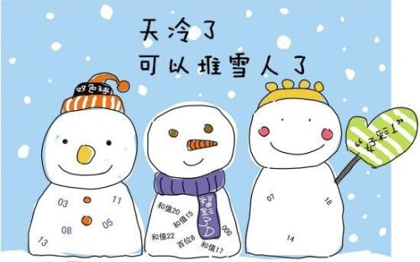
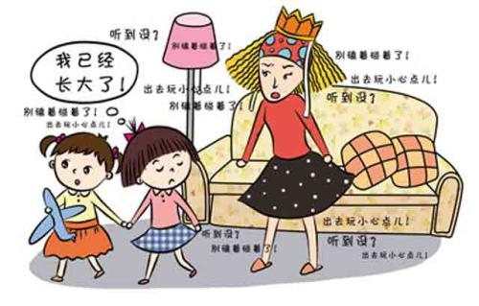
5）继续保持或处于原来的状态
keep，remain，stay，stand
e.g.The weather remains cold. Keep quiet,please
天气依然很冷。

Slide 51
Exercise
1. The poor boy ____ blind at the age of three.
A. turned B. goes C. became D. went
2. His voice____ as if he has a cold.
A. sounds B. listens C. hears D. seems
3. When I went home yesterday, it was ____ dark.
A. going B. getting C. running D. coming
4. You____ very pale. Do you feel sick?
A. looked B. look C. looking D. are looked

Slide 52
Exercise
is
1.Peter’s mother _____an engineer.
2.The weather _______colder and colder.
3.The dish ______ good.
4.The story _________interesting.
5.The dish of yours ______delicious.
6.He ______to be very sad.
7.This kind of cloth _______very soft.
8.She _______rich within a short time.
turns
smells
sounds
tastes
seems
feels
grew

Slide 53
02.动词的用法
2.4 助动词

Slide 54
助动词
has/had
be
She has been to Beijing three times.
We are working hard in the garden.
Look, some girls are singing in the classroom.
will/shall
do/does/did/done
I will call you this evening.
What shall we do next week?
He doesn’t like to have hamburgers.
Did you live in Shanghai?

Slide 55
助动词 Auxiliary Verb
助动词，它本身无词义，不能单独使用，作用是协助主要动词构成谓语动词。
e.g. Mary doesn't like music.
(doesn't是助动词，无词义; like是主要动词，有词义)

Slide 56

判定以下助动词的作用
We are having an English class.
I have seen the film.
He didn’t go home last night.
We will fly for Africa next month.
帮助主要动词have构成现在进行时
帮助主要动词see构成现在完成时
帮助主要动词go构成一般过去时
帮助主要动词fly构成一般将来时

Slide 57

He was sent to England.
I would fly to Canada if I were a bird.
Had I lived in London, I would have been to
London Bridge.
帮助主要动词send构成被动语态
帮助主要动词构成虚拟语气
帮助主要动词构成虚拟语气

Slide 58
1. 助动词be的用法
b. 表示命令
You are to explain this. 对此你要做出解释。
He is to come to the office this afternoon.
要他今天下午来办公室。
c. 征求意见
How am I to answer him? 我该怎样答复他？
Who is to go there? 谁该去那儿呢？
d. 表示相约、商定
We are to meet at the school gate at seven tomorrow morning.
我们明天早晨7点在校门口集合。

Slide 59
1. 助动词be的用法
1） be +现在分词，构成进行时态
They are having a meeting.
English is becoming more and more important.
2）be + 过去分词，构成被动语态。
The window was broken by Tom.. 窗户是汤姆打碎的。
English is taught throughout the world. 世界各地都教英语。
3） be + 动词不定式，可表示下列内容：
a. 表示最近、未来的计划或安排。
He is to go to New York next week.. 他下周要去纽约。
We are to teach the freshmen. 我们要教新生。

Slide 60
Exercise
1. What are you doing? I’m_____ an interesting book.
A. looking B. seeing C. reading
2.Don’t talk here. My grandmother _____.
A. is sleeping B. are sleeping C. sleeping D. sleep
3. Listen! The birds ___ in the tree .
A. sing B. singing C. is singing D. are singing
4.Tea______in the south of China.
A. grows B. is grown C. were grown D. will grow
5.The bridges ______two years ago.
A. is built B. built C. were built D. was built

Slide 61
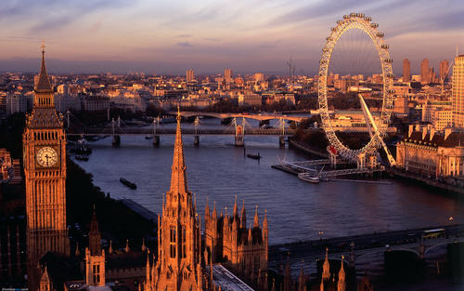
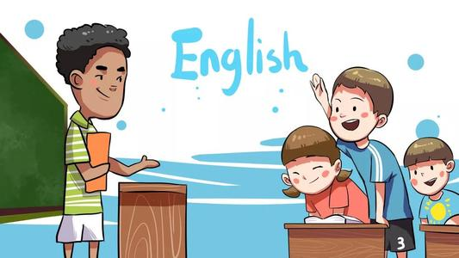
2. 助动词have的用法
1）have +过去分词，构成完成时态。
He has left for London. 他已去了伦敦。
2）have + been +现在分词，构成完成进行时
I have been studying English for ten years.
3）have +been +过去分词，构成完成式被动语态。
English has been taught in China for many years.

Slide 62
Exercise
1. Our country_____ so far.
-Yes, I hope it will be even_____.
A.has changed;well B. changed;good
C. has changed;better D. changed;better
2.Harry Potter is a very nice film, I _____it twice.
A. will see B. have seen C. saw D. see
3. _____you____your homework yet?
-Yes, I ______it a moment ago.
A. did ;do;finished B. have;done;finished
C. have; done; have finished D. will;do;finish

Slide 63
3. 助动词do的用法
1）构成一般疑问句。
Do you want to pass the CET?
2）do + not 构成否定句。
He doesn't like to study.
变疑问句时
如果句子中没有be动词、情态动词，则需要借助助动词do,
does或did，将它们放在句首，并将句中实义动词变为原
形，若主语为第一人称I， 则改为第二人称you，my改成
your!
◆ 注意：do, does, did后面必须使用动词原形。

Slide 64
各种句式
1. My parents/I usually take a walk after dinner.
陈述句
Do your parents/you usually take a walk after dinner?
一般疑问句
-Yes, they/I do./ No they/I don’t
回答
2. Jack usually takes a walk after dinner.
陈述句
Does Jack usually take a walk after dinner?
一般疑问句
-Yes, he does./No he doesn’t
回答
陈述句
3.Mike went to school by bus last week.
Did Mike go to school by bus last week?
一般疑问句
Yes, he did. / No, he didn’t.
回答
4.They go to school by bus on weekdays
陈述句
They don’t go to school by bus on weekdays.
否定句

Slide 65
Exercise
1. Tom and I ______ speak Chinese.
A. do B. don't C. does D. doesn't
2. Lucy doesn't_______yellow.
A. like B. likes C. has liked D. liked
3.What______they_____on Sundays？
A. does；does B. do;do C. does;do D.do;does
4.Do you like red?
-______
A. Yes, I don't B. Yes,I do C.No, I do D.No, I doesn't

Slide 66
3. 助动词do的用法
3） 构成否定祈使句。
Don't be so absent-minded.不要这么心不在焉
说明： 构成否定祈使句只用do，不用did和does。
4）放在动词原形前，加强该动词的语气。
Do come to my birthday party.
I did go there. 我确实去那儿了。
5）用于倒装句。
Never did I hear of such a thing.

Slide 67
4. 助动词shall和will的用法
shall和will作为助动词可以与动词原形一起构成一般将来时。
1. Shall在问句中,用于一，三人称，征求对方意见…好吗?要不要…？
Shall I help you carry that box?
Shall we go out for a meal tonight?
2.will 主要构成将来时。
He will go to Shanghai.
3.should无词义，只是shall的过去形式，与动词原形构成过去将来时，只用于第一人称。
I telephoned him yesterday to ask what I should do next week.
4.would也无词义，是will的过去形式，与动词原形构成过去将来时，用于第二、第三人称。
He said he would come.

Slide 68
Exercise
1. ----____he come in or wait outside?
----Let him in,please.
A.Shall B.Will C.Does D.Has
2. — The room is so dirty. ____ we clean it?
— Of course.
A. Will B. Shall C. Would D. Do
3.The students_______if it doesn't rain tomorrow.
A. will plant trees B.plant trees
C. would plant trees D.plants trees

Slide 69
02.动词的用法
2.5 情态动词

Slide 70
概念：
情态动词主要用于表明说话者对某一行为的态度和观点，包括能力、可能、义务、必要、允诺、建议、禁止、愿望、猜测、责备等。
情态动词是“辅助性”动词，必须和动词原形一起构成谓语。
情态动词之间一般是相互排斥的，不能连用。
多数情态动词没有人称和数的变化，部分情态动词有时态的变化。
重点关注：“情态动词+have+过去分词”的结构（具体参见P121表格）

Slide 71

一学就会
1. 表示能力时，意为“能、会”can指现在，could指过去。
Some of us can use the computer now,
but we couldn’t last year.
can
2. 表示请求或许可时，意为“可以“could 代替 can 使语气更委婉。
Can/Could I use your dictionary?
3. 表示猜测时，意为“可能”。往往用于否定句和疑问句。用于疑问句时，can比could的可能性大，用于否定句时cannot 表示“不可能”，can’t be 一定不是。
Where can she go now?
It can`t be my teacher. He is in his office now.

Slide 72
一学就会
4. can’t/ couldn’t have done 表示对过去情况的否定推测,意为“过去不可能做过某事”
①Mary can’t have written a report like this.
②She can’t have gone to school, it is Sunday .
can
5. can/could have done
表对过去的推测，意为“过去可能做了某事”。
could have done
还可以表示对过去能做而未做的事情感到惋惜，
意为“本能够做某事可事实上未做”
①It’s a pity. Your class could have got the first prize.
②Where can Mary have gone?

Slide 73
注意：can 和 be able to
be able to同can也可表“能、会”,表示能力时，二者可互换。
can 强调自身具有的能力，而be able to往往指经过一番努力才获得的能力。
can只有一般现在时和一般过去时两种时态形式，be able to有一般现在时、一般过去时、将来时和完成时等多种时态形式。
can没有单复数形式的变化，be able to有。
can前不能用其他情态动词，be able to 前可用其他情态动词；

Slide 74
Exercise
1. Mike ____ be a policeman, for he’s much too short.
A. needn’t B. can’t C. should D. may
2. Mr. Bush is on time for everything. How ____ it be
that he was late for the opening ceremony?
A. can B. should C. may D. must
3. My sister met him at the cinema yesterday afternoon,
so he ____ your lecture.
A. couldn’t have attended B. needn’t have attended
C. mustn’t have attended D. shouldn’t have attended

Slide 75
Exercise
5. There’s someone outside. Who ____it be?
A. can B. need C. may D. must
6. ----Is Jack on duty today?
----It ____ be him. It’s his turn tomorrow.
A. mustn’t B. won’t C. can’t D. needn’t
7. It is usually warm in my hometown, but it ____be rather
cold sometimes.
A. can B. need C. dare D. must

Slide 76
1.表示请求或允许时，意为“可以、准许”。
否定式是mustn't
May I go home, please?
Yes, you can./No, you mustn`t
may
2.表示推测时，意为“可能、也许”。
I think it may rain this afternoon.
我想今天下午可能下雨。
3.may的过去式为might，表示推测时，可能性低于may。
He might not come today. 今天他也许不来了。

Slide 77
4.may/might have done 表示对过去发生过的事情的推测，意为“可能已经做过某事”
may
I can’t find my sunglasses.
I may/might have left them in your office.
5. may/ might as well + 动词原形 “…还是…的好” “不妨干某事”
You may as well go and have a look.

Slide 78
注意：may 和 might
might 是may的过去式，且might比may更含蓄、委婉。
在表达可能性时，might表示的可能性更小。

Slide 79
Exercise
1.Sorry I'm late. I _____ have turned off
the alarm clock and gone back to sleep again.
A. might B. should
C. can D. will
2.Peter _____ come with us tonight,
but he isn’t very sure yet.
A. must B. may
C. can D. will

Slide 80
1.表示义务、必要或命令时，意为“必须，应该”。
You must come early tomorrow.
2.表示推测时，意为“肯定，一定”用must be。
must
They must be at home. The light is on.
3.must not(mustn’t)表示禁止，意为“不能，不许”，是may的否定式。must 表示“不应该，没必要” 的否定式是needn't。
You must not tell lies.
Must I come before 6:30 tomorrow ?
Yes, you must./ No, you needn`t.

Slide 81
Exercise
1.--What’s the matter with the man hanging his head there?
---Well. If you ___know, he was caught stealing my bike.
A.must B. may C. can D. shall
2. Must we clean the house now? No, you _______.
A. needn't B. may not C. mustn't D. can't
3.—Must I finish the work today?
—No, you _____. You _____ finish it tomorrow.
A. mustn’t; must B. needn’t; may C. can’t; may

Slide 82
4.must have done”一定做了...”表示 对过去情况的肯定推测，语气较强。，其否定为can’t/couldn’t have done ”过去不可能了....”
must
You must have read this book，because he knows the characters in the book.
他一定读了这本书，因为他知道书中的人物。

Slide 83
注意：must 和 have to
两者都表示“必须、不得不”。
must强调主观看法，表示说话人主观上认为有必要做某事。
have to强调客观需要，表示客观环境促使其不得不做某事。
must没有过去或将来时态；have to有多种时态。
must没有单复数形式，have to 有单复数形式。
must not（mustn’t）意为“不准、不允许、千万别”；don’t have to意为“不必，没必要”。

Slide 84
1.用于表劝告、建议。 意为”应该、应当”。在疑问句中常用should
Should I go home, please?
Yes, you should./No, you shoudn’t.
should
2. should have done 本应该做某事可事实未做
shouldn’t have done本不该做某事可事实却做了
needn’t have done本不必做某事可事实却做了
①You should have invited me to the party yesterday.
②You are right. I Should have thought of that.
③You shouldn’t have eaten all the cakes in one day.

Slide 85
3.用在某些由that引导的从句中，表示“竟然”，含有某种强烈的情感。
should
You cannot imagine that he should become a soldier.

Slide 86
1.意义同should。用于表劝告、建议。 意为”应该、应当”。
The rain has stopped，and it ought to be warmer.
ought to
2. (同should)
ought have done 本应该做某事可事实未做
oughtn’t have done本不该做某事可事实却做了
①You ought to have told him that the paint on that seat was wet.
②You oughtn’t to have given him more help.

Slide 87
注意：should 和 ought to
should 语气较轻，ought to语气较重。
2. ought to适用于所有人称和时态，to后面应跟动词原形，其否定式是：ought not to，缩写为oughtn’t to.

Slide 88
Exercise
1.You can’t imagine that a well-behaved gentleman _____
be so rude to a lady.
A. can B. should C. may D. must
2. ---- When can I come for the photos? I need them
tomorrow afternoon.
---- They _____ be ready by 12:00
A. can B. should C. might D. need

Slide 89
1. 作情态动词，+V原形，常用于否定、疑问、条件句中，表示“敢于、胆敢”。否定式：dare+not，daren’t
They dare not ask for more money.
How dare you do such a thing.
dare
2. 作行为动词，常用作及物动词，表示“敢于，激”，
其否定式：don’t/ doesn’t/didn’t +dare；
一般疑问句用do/does/did提问；
dare to do sth. 敢做某事
dare sb. to do sth. 激某人做某事
①He didn’t dare to say what he tought.
②I dare him to say something he should keep secret.

Slide 90
1. 作情态动词，+V原形，常用于否定、疑问中，表示“需要”。否定式：need+not，needn’t；
needn’t have done “过去本不必做，却做了”
There need be no hurry, need they?
You needn’t go there if you don’t want to.
need
2. 作行为动词，表示“需要，有必要“
可以+宾语；也可构成need to do结构
其否定式：don’t/ doesn’t/didn’t +need；
一般疑问句用do/does/did提问；
①Plants need light in order to survive.
②They need to get the contract.

Slide 91
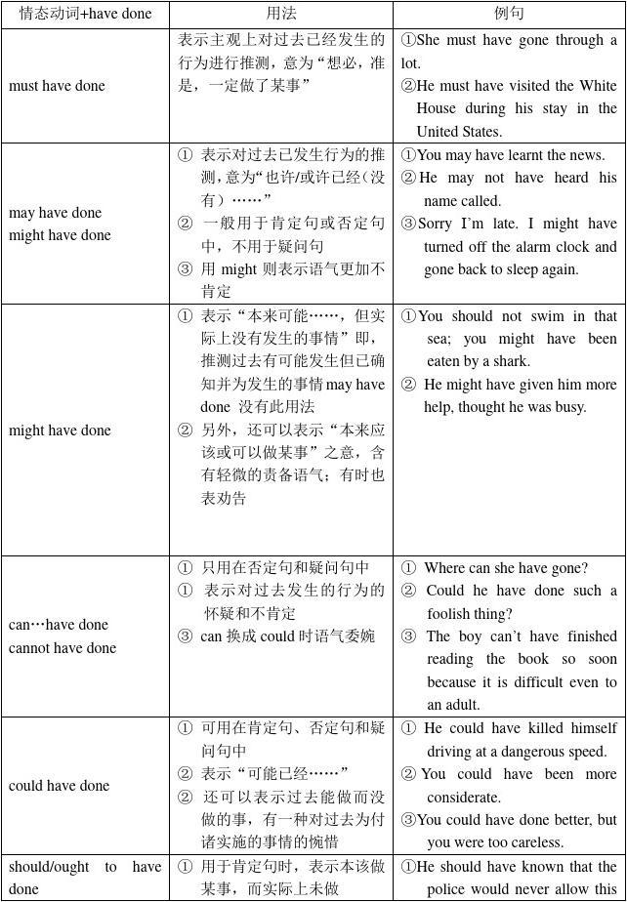
P121

Slide 92
02.动词的用法
2.6 重点动词及词组

Slide 93
get
reach
arrive
1
①单独的get 是没有表示“到达”之意的，它必须和to 连用才能表示到达。
How can I get to the hospital?
②接表地点的副词则“to”省去。
I got home at five o’clock in the afternoon.
I didn’t get here until twelve thirty.
2
reach是及物动词，后面直接接表地点的名词或副词，不需加任何介词。
They reached Hangzhou yesterday.
When did you reach home?
3
arrive 是不及物动词，它后接地点名词须加介词at或in .大地方用in ,小地方用at.
接there ,here 或home等地点副词是不用介词in或at.
I arrived at the company three hours ago.
Tom arrived home at three.

Slide 94
Exercise
1.When he arrived _____ the station, the train had left.
A to B in C at D /
2.Please tell me when the bus__________.
A arrives B arrives at C reaches D reaches in
3.With the help of the Internet, news can ___ every corner of the world.
A go B get C arrive D reach
4. Jane ________ the USA a few days ago.
A arrived B arrived in C reached to D arrived to
5.Jim and Kate are ________ at their hometown tomorrow.
A getting to B getting C reaching D arriving

Slide 95
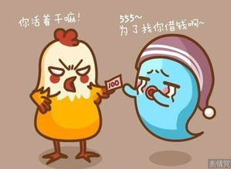
lend借出
borrow借进
I can lend you
100 yuan.
Can I borrow
100 yuan?

Slide 96
lend借出
borrow借进
★ lend (lent, lent）
用法：lend sth to sb
lend sb sth(可接双宾语)
◆Mary lent 20yuan to me yesterday.
◆ Mary lent me 20yuan yesterday.
★borrow
用法: borrow sth from sb
◆I borrowed a book from Mary yesterday.

Slide 97
Exercise
1.Can I ___ your book?
—Sure,here you are.
—How long may I ___it?
A.lend/lend B.borrow/keep C.lend/keep D.borrow/lend
2.Could you ___ me your dictionary? I want to find the
meaning of this new word.
A. keep B. lent C. borrow D. lend
3. I can ___ you my dictionary, but you can ____ it for only
a week.
A. borrow; borrow B. lend; borrow
C. borrow; keep D. lend; keep

Slide 98
see
look
watch
read
1
see意为“看到;看见”，指有意无意地看到，强调看的结果，无进行时态。
I look outside but I can’t see anything.
Look!Can you see a bird?
是及物动词，常与一些名词构成词组，如see a film(看电影), see a doctor(看医生)。
2
look意为“看”，表示有意识的看，不管结果如何，只强调看的动作。
是不及物动词，后面不能带宾语，如果跟宾语，要和at连用。
e.g. please look at the blackboard.
常单独使用，以引起对方注意
Look! How happily they are playing！

Slide 99
see
look
watch
read
3
watch意思是“看”、“观看”、“注视”，指全神贯注地看。
看戏、电视、比赛、实验、表演等一般用watch 。
特别留意、感兴趣的看运动着的东西，强调带有欣赏性的看。
例如：He watches TV only on Saturday evening ．
4
read 指“看”时实指“阅读”，常用于看书、看报等。
例如：I like reading at home.我喜欢在家看书。
看书read a book，看报纸read a newspaper，
看杂志read a magazine

Slide 100
Exercise
1.I like to _____ newspapers when I am free.
2.He stands at the window and______ a policeman.
3.____！The bus is coming.
4.The little boy likes_____TV very much.
5.He will go to ______a volleyball match.
6.How many birds can you ___ in the tree?
7.Does Lily often go to ___ a film on Sunday?
read
sees
Look
watching
watch
see
see

Slide 101
bring
take
fetch
carry
1、bring “拿来，带来”，指从别处带到说话处。
Remember to bring your books to school tomorrow .
2、take “拿去带去”，把某物（人）从说话处带到别处，与bring相反。
Take your schoolbag to your room.
3、fetch则表示"去拿来"(go and bring)的意思
Please fetch me the documents in that room.
4、carry “搬运；携带”，没有方向性。
Can you carry the box to classroom for me ?

Slide 102
Exercise
1._______ this coat away and _________ me mine.
2. I had to ________ my suitcases all the way to the hotel.
3. Please _______ my hat to me tomorrow.
4.________ your umbrella when you go out.
5. --Come and stay for the weekend and _______ your friend.
----Thanks, I’d love to. Can we _______ the children too?
6.She has gone to _______water.
Take
bring
carry
bring
Take
bring
bring
fetch

Slide 103
speak
say
talk
tell
1. ①speak作及物动词，意为“说”“讲”，其宾语常是某种语言。
speak French说法语；
② speak也作不及物动词，主要表示说话的本能和方式，发言等。
The baby is learning to speak．
speak+ 语言
speak to sb.
2.say是“讲，说”的意思，强调说话内容。
一般作及物动词，常用于直接引述所说的话或间接叙述所说的话。 Say it in Chinese please． He says ″It‘s great．
He says that he saw the man yesterday．
①say+ 说话内容
②say to sb.
③It is said that... 意为“据说”。如：
It is said that he could stay under the water for a long time.

Slide 104
speak
say
talk
tell
3.talk意为“讲、谈论，谈话”是不及物动词，如： They are talking about the film． The teacher is talking with Mike．
①talk to/ with sb. about sth. ②have a talk with “与......交谈”
③give a talk做报告 （talk n.报告） ④have a talk听报告
4.tell意为“告诉,对…说”.作及物动词，如： I can‘t tell the bad news to you．＝I can’t tell you the bad news．
My mother tells me to buy some fruit．
①tell sb. sth.／ tell sth. to sb./tellsb.about sth
②tell sb. to do sth．
③tell a story讲故事 ④tell the truth 说真话 ⑤tell a lie说谎
⑥tell : 辨别，说出区别 tell A from B

Slide 105
Exercise
1. Did he _____ it in English?
A. tell B. speak C. say D. talk
2. The teacher _____ us to finish the homework in time.
A.tells B. speaks C. says D. talks
3.What would you like to ______ something about your hometown?
A. speak B. talk C. say D. tell
4.Please ＿＿＿ me the news．
5.The teacher is ＿＿＿＿ loudly to the students．
tell
speaking

Slide 106
spend
cost
take
pay
人作主语： pay、spend
物作主语： cost、take
一、主语是人 1. pay: 花费...钱
sb. pay money for sth. 付钱...买…
eg:Tom pays 15 yuan for the bike.
2.spend: 花费钱或时间
① sb. spend time ／money on sth. 在……上花费时间/金钱。
eg. Lily spent ten yuan on this pen.
② sb. spend time ／money (in) doing sth. 花费时间/金钱做某事。
eg. Lily spent ten yuan (in) buying this pen.

Slide 107
spend
cost
take
pay
人作主语： pay、spend
物作主语： cost、take
二、主语是物
1、cost: 花费钱
sth. cost (sb.) + money,某物花了（某人）多少钱。
eg. A new computer costs me 3000 yuan.
These books cost me 10 yuan.
2、take：花费时间 （主语通常是It）
It takes sb. ＋some time＋to do sth. 做某事花了某人多少时间。
eg:It takes me half an hour to clean my room.
It takes her two hours to finish her homework.

Slide 108
Exercise
1. They spend too much time the report.
A.writing B. to write C. on writing D. write
2. --What beautiful shoes you’re wearing!
They must be expensive
--No，they only____ l0 yuan．
A．spent B．took C．paid D．cost
3. --Will you please ____ for my dinner Peter?--Sure!
A. spend B. pay C. cost D.take
4. It will ____ me too much time to read this book.
A. take B. cost C. spend D.pay

Slide 109
look for
find
find out
1）look for意为“寻找”，是有目的地找，强调“寻找”这一动作。 —What are you looking for？ —I'm looking for my bike．
2）find意为“找到”“发现”，强调“找”的结果，
其宾语往往是某个丢失的东西或人。 —Did you find Li Ming yesterday？ —No，we looked for him everywhere，but didn't find him．
3)find out意为“找出、发现、查明”，多指通过调查、寻问、打听、研究
之后“搞清楚、弄明白”，通常含有“经过困难曲折”的含义，指找出较
难找到的、 无形的、抽象的东西。 Read this passage，and find out the answer to this question.

Slide 110
Exercise
1.Jim couldn’t ______ his hat.
2. I can’t_______ my book.
3. She is ___________her son.
4. I’m ___________my watch.
5.Please _______ when the train leaves. 6.Who can __________the answer?
find
find
looking for
looking for
find out
find out

Slide 111
join
take part in
join in
1)加入某党派、某组织或某社会团体,用join.
①He will never forget the day when he joined the Party.
②His brother joined the army three years ago.
join还可解释为“连接”.如：
The railway joined the two cities.
2）take part in参加(群众性活动、会议等),往往指参加者持积极态度．
We are going to have an English evening.Do you want to take part?
3) join in多指参加小规模的活动如“竞赛、、娱乐、游戏”等
Come along, and join in the ball game.快,来参加球赛.

Slide 112
Exercise
1.My brother ______ the army in 2002.
2. I didn’t want to_____________ their argument.
3. May i ___________the competition?
4.We are playing football. Do you want to_______?
5.You are welcome _______ us.
joined
take part in
join in
join in
join

Slide 113
lose
fail
beat
win
1)lose ，fail都有失败的意思
lose的用法是lose the match .lose to sb.
fail 常用fail in doing sth; fail to do sth中
2）beat意为“战胜，击败，打，敲”，
过去式是beat,过去分词是beaten。
其后所跟宾语可以是人或团队
We beat the team from No.1 Middle School.
3) win意为“赢得”，过去式和过去分词都是won。
其后所跟宾语可以是：名次、荣誉、奖牌……，即
prize/match/game/medal/war/battle/the first place/respect...
—Who won the game at last?

Slide 114
Exercise
1. —Grace ____ the first prize in the swimming race last week.
—You mean she ____all the other swimmers？
A. won; won B. beat; won C. won; beat
2. —Did Mike ____ the table tennis match?
—No, he didn’t. Tom beat him.
A. won B.win C. beat

Slide 115
关注P126-131动词搭配，你会成为得分小可爱
温馨提示

Slide 116
Thanks

